Slide 1
Soft Computing
Contents -
Fuzzy logic : Introduction to Fuzzy logic
Fuzzy sets and membership functions
Operations on Fuzzy sets
Fuzzy relations, rules, propositions, implications and inferences
Defuzzification techniques
Fuzzy logic controller design
Some applications of Fuzzy logic
UNIT -2

Slide 2
Fuzzy logic : Introduction to Fuzzy logic
Fuzzy Logic helps work with situations where the information is unclear or partly true. Instead of only 0 or 1 like traditional logic, it allows values between 0 and 1 to represent partial truth. This makes it useful in real-world decision-making where data is not exact.
Handles uncertainty and vague information.
Works with partial truth values between 0 and 1.

Slide 3
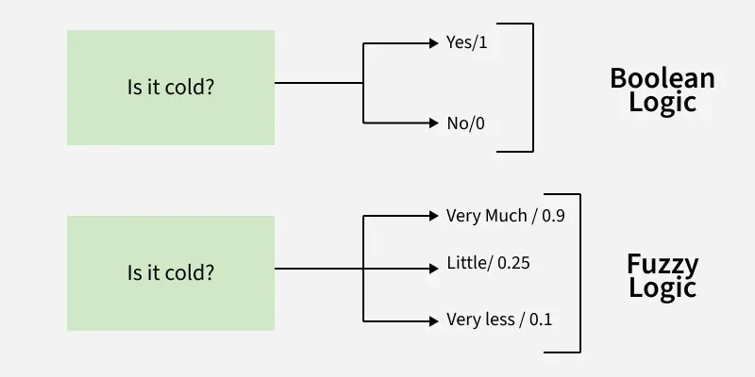
Fuzzy logic : Introduction to Fuzzy logic
Useful in control systems, medical diagnosis, AI and image processing.
Helps systems take flexible and human-like decisions.

Slide 4
Key Concepts of Fuzzy Logic
Membership Function:
It defines how much an input belongs to a particular category. For example, in a fuzzy temperature control system, a temperature of 70°F might belong 0.8 to the "warm" category and 0.2 to the "cool" category.
Fuzzy Sets:
These are sets where elements have degrees of membership. For example, the "young" age group might include someone who is 30 with 0.7 membership (mostly young) and someone who is 50 with 0.3 membership (partly young).

Slide 5
Key Concepts of Fuzzy Logic
Linguistic Variables: These are variables defined using terms rather than precise numbers. For example, "temperature" could be a linguistic variable with terms like "cold," "warm" and "hot."

Slide 6
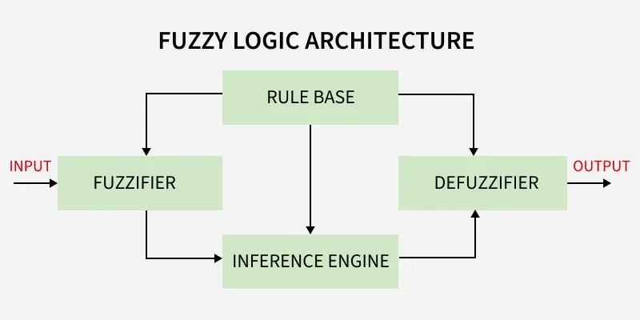
Fuzzy Logic Architecture

Slide 7
Fuzzy Logic Architecture
Fuzzy Logic systems are made up of four main components that work together to process imprecise or uncertain data:
Fuzzification:
It is the process of converting precise input values(such as temperature or pressure readings) into fuzzy sets. This step is important because real-world inputs like those from sensors aren’t perfect or exact.

Slide 8
Fuzzy Logic Architecture
Rule Base:
A collection of "if-then" rules created by experts to guide the system's decisions. These rules use natural language terms (like "high," "low," "warm") to describe conditions and actions.
Inference Engine:
It evaluates the fuzzified input data and applies the relevant rules from the rule base. It find which rules are most appropriate and then combines the results to generate a control action.

Slide 9
Fuzzy Logic Architecture
Defuzzification:
Once the inference engine processes the rules and generates fuzzy outputs, it converts these fuzzy results back into a precise, crisp value. This final step ensures that the system can take clear actions based on the fuzzy logic outputs.

Slide 10
Membership Functions
A membership function describes how much an input value belongs to a fuzzy set. It assigns a value between 0 and 1 to each point in the input space also called the universe of discourse :
0 -> the value does not belong to the set
1 -> the value fully belongs to the set
Values in between -> partial membership
These functions are a key part of fuzzification, helping translate precise real-world data into fuzzy values that can be processed by the system.

Slide 11
Common Types of membership functions:
Singleton:
Represents a crisp value as a fuzzy value at one specific point.
Gaussian:
Based on the Gaussian curve, this allows smooth transitions between membership degrees.

Slide 12
Common Types of membership functions:
Trapezoidal or Triangular:
It uses straight-line shapes to define how membership changes across a range of values.
By choosing the right membership function, we can represent uncertainty more naturally and make fuzzy logic systems respond in a way that feels closer to human reasoning.

Slide 13
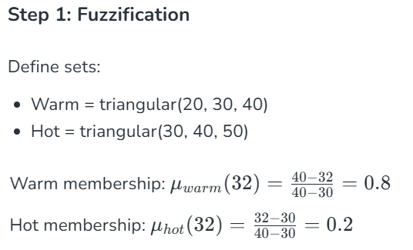
Numerical Example
Input:
Temperature = 32°C
Goal: Adjust fan speed (Low / Medium / High)

Slide 14
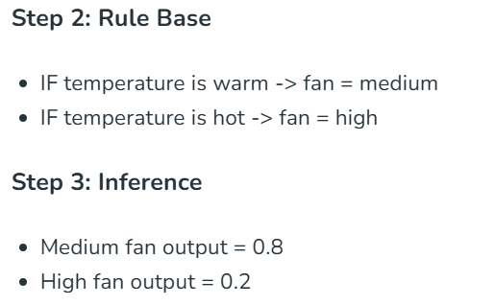
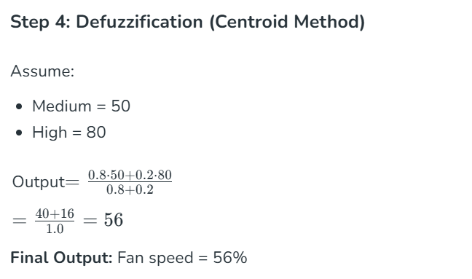

Slide 15
Fuzzy Control
Fuzzy control is a method of designing systems that make decisions in a way similar to human reasoning. Instead of depending only on exact values, it works with approximate information to produce results that are practical and acceptable, even if they aren’t perfectly precise. This approach is useful when dealing with uncertainty or incomplete data, situations where traditional control methods might fail.
Example: In an air conditioning system, fuzzy control can adjust the cooling not just as “on” or “off” but based on degrees like “slightly cool” or “very cool,” creating smoother and more comfortable temperature control.
By capturing the flexibility of human decision-making, it helps systems operate effectively in complex, unpredictable environments.

Slide 16
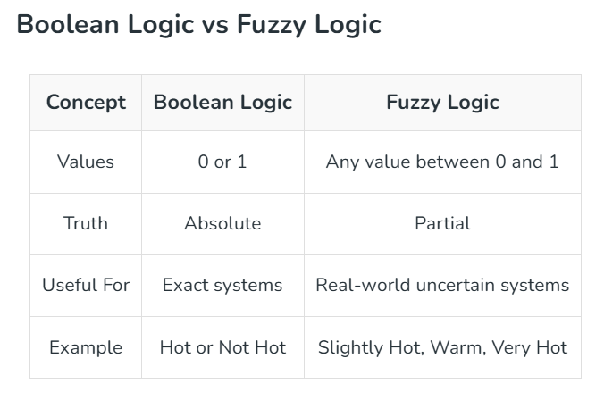

Slide 17
Applications of Fuzzy Logic
Fuzzy logic is used in many fields where precision isn’t always possible:
Aerospace: Fuzzy logic is used in spacecraft and satellite altitude control systems.
Automotive: It's applied in speed control and traffic management systems.
Industrial: It is used for processes like pH control, drying and distillation in the chemical industry.
Artificial Intelligence: In areas like natural language processing and decision-making support systems.
Control Systems: It is integral to many modern control systems including expert systems and robotics.

Slide 18
Advantages of Fuzzy Logic
Fuzzy logic systems has several benefits which are as follows:
Handles imprecise or noisy data: Whether the data is distorted or not completely accurate, it can still make sense of it.
Easy to design and understand: Unlike many complex algorithms, fuzzy logic systems are straightforward and simple to implement.
Efficient for complex problems: Fuzzy logic mirrors human reasoning, so it’s great for solving problems in many areas like decision-making or control systems.
Low memory requirements: The algorithms are simple and can operate with little data.

Slide 19
Disadvantages of Fuzzy Logic
While fuzzy logic has many strengths, it also comes with some challenges :
Ambiguity: Different researchers may propose different solutions to the same problem, making the approach less systematic.
Difficulty in proving correctness: Since fuzzy logic deals with uncertainty, proving that a system works as expected can be tricky.
Accuracy compromises: Because fuzzy logic deals with both precise and imprecise data, the system might sacrifice some level of accuracy.

Slide 20
Fuzzy Logic - Classical Set Theory
A set is an unordered collection of different elements. It can be written explicitly by listing its elements using the set bracket. If the order of the elements is changed or any element of a set is repeated, it does not make any changes in the set.
Example -
A set of all positive integers.
A set of all the planets in the solar system.
A set of all the states in India.
A set of all the lowercase letters of the alphabet.

Slide 21
Mathematical Representation of a Set
Sets can be represented in two ways −
Roster or Tabular Form -
In this form, a set is represented by listing all the elements comprising it. The elements are enclosed within braces and separated by commas.
Following are the examples of set in Roster or Tabular Form −
Set of vowels in English alphabet, A = {a,e,i,o,u}
Set of odd numbers less than 10, B = {1,3,5,7,9}

Slide 22
Set Builder Notation
In this form, the set is defined by specifying a property that elements of the set have in common.
The set is described as A = {x:p(x)}
Example 1 − The set {a,e,i,o,u} is written as
A = {x:x is a vowel in English alphabet}
Example 2 − The set {1,3,5,7,9} is written as
B = {x:1 ≤ x < 10 and (x%2) ≠ 0}

Slide 23
If an element x is a member of any set S, it is denoted by x∈S and if an element y is not a member of set S, it is denoted by y ∉S.
Example − If S = {1,1.2,1.7,2},1 ∈ S but 1.5 ∉ S
Cardinality of a Set
Cardinality of a set S, denoted by |S||S|, is the number of elements of the set. The number is also referred as the cardinal number. If a set has an infinite number of elements, its cardinality is ∞∞.
Example − |{1,4,3,5}| = 4,|{1,2,3,4,5,}| = ∞

Slide 24
If there are two sets X and Y, |X| = |Y| denotes two sets X and Y having same cardinality. It occurs when the number of elements in X is exactly equal to the number of elements in Y. In this case, there exists a bijective function f from X to Y.
|X| ≤ |Y| denotes that set Xs cardinality is less than or equal to set Ys cardinality. It occurs when the number of elements in X is less than or equal to that of Y. Here, there exists an injective function f from X to Y.
|X| < |Y| denotes that set Xs cardinality is less than set Ys cardinality. It occurs when the number of elements in X is less than that of Y. Here, the function f from X to Y is injective function but not bijective.
If |X| ≤ |Y| and |X| ≤ |Y| then |X| = |Y|. The sets X and Y are commonly referred as equivalent sets.

Slide 25
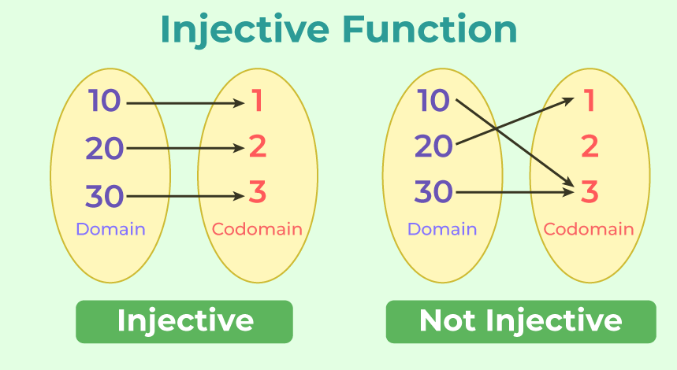
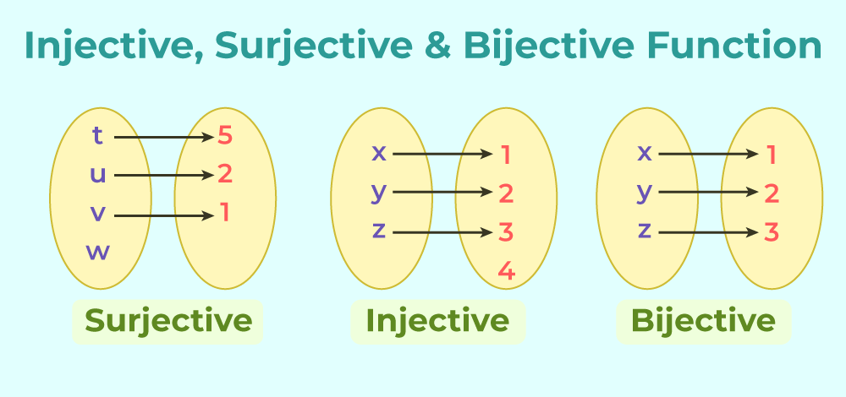

Slide 26
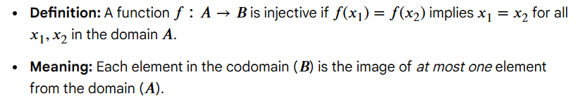
In set theory, an injective function (one-to-one) maps distinct inputs to distinct outputs, ensuring no output is shared by multiple inputs (at most one preimage).
A bijective function (one-to-one correspondence) is both injective and surjective, meaning every input maps uniquely to an output, and every output is hit by exactly one input, creating a perfect pairing between sets.
Injective (One-to-One) Function Definition:

Slide 27
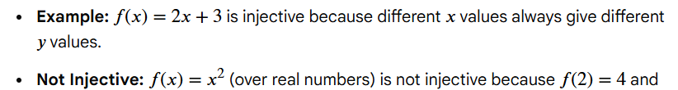
Bijective (One-to-One Correspondence) Function
Definition: A function is bijective if it is both injective and surjective (onto).
Surjective (Onto) Property: Every element in the codomain (\(B\)) has at least one corresponding element in the domain (\(A\)).
Bijective Meaning: Every element in the domain maps to exactly one unique element in the codomain, and vice versa, creating a perfect pairing.

Slide 28
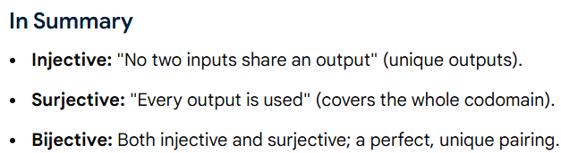
Key Implication: For a bijection, the number of elements in the domain and codomain must be equal (sets are the same size).
real numbers.

Slide 29

Types of Sets
Sets can be classified into many types; some of which are finite, infinite, subset, universal, proper, singleton set, etc.
Finite Set
A set which contains a definite number of elements is called a finite set.
Infinite Set
A set which contains infinite number of elements is called an infinite set.

Slide 30
Types of Sets
Subset
A set X is a subset of set Y (Written as X ⊆ Y) if every element of X is an element of set Y.
Example 1 − Let, X = {1,2,3,4,5,6} and Y = {1,2}. Here set Y is a subset of set X as all the elements of set Y is in set X. Hence, we can write Y⊆X.
Example 2 − Let, X = {1,2,3} and Y = {1,2,3}. Here set Y is a subset (not a proper subset) of set X as all the elements of set Y is in set X. Hence, we can write Y⊆X.

Slide 31
Types of Sets
Proper Subset
The term proper subset can be defined as subset of but not equal to. A Set X is a proper subset of set Y (Written as X ⊂ Y) if every element of X is an element of set Y and |X| < |Y|.
Example − Let, X = {1,2,3,4,5,6} and Y = {1,2}. Here set Y ⊂ X, since all elements in Y are contained in X too and X has at least one element which is more than set Y.
Universal Set
It is a collection of all elements in a particular context or application. All the sets in that context or application are essentially subsets of this universal set. Universal sets are represented as U.

Slide 32
Types of Sets
Example
− We may define U as the set of all animals on earth. In this case, a set of all mammals is a subset of U, a set of all fishes is a subset of U, a set of all insects is a subset of U, and so on.
Empty Set or Null Set
An empty set contains no elements. It is denoted by Φ. As the number of elements in an empty set is finite, empty set is a finite set. The cardinality of empty set or null set is zero.

Slide 33
Types of Sets
Singleton Set or Unit Set
A Singleton set or Unit set contains only one element. A singleton set is denoted by {s}.
Equal Set
If two sets contain the same elements, they are said to be equal.
Example − If A = {1,2,6} and B = {6,1,2}, they are equal as every element of set A is an element of set B and every element of set B is an element of set A.

Slide 34
Types of Sets
Equivalent Set
If the cardinalities of two sets are same, they are called equivalent sets.
Example − If A = {1,2,6} and B = {16,17,22}, they are equivalent as cardinality of A is equal to the cardinality of B. i.e. |A| = |B| = 3
Overlapping Set
Two sets that have at least one common element are called overlapping sets. In case of overlapping sets −

Slide 35
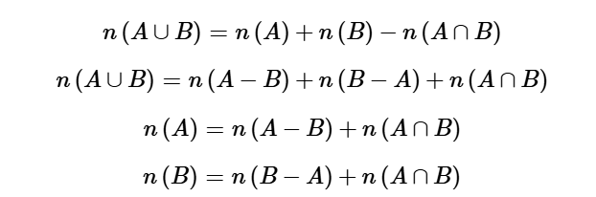
Types of Sets
Example
− Let, A = {1,2,6} and B = {6,12,42}. There is a common element 6, hence these sets are overlapping sets.

Slide 36
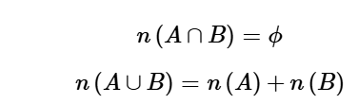
Types of Sets
Disjoint Set
Two sets A and B are called disjoint sets if they do not have even one element in common. Therefore, disjoint sets have the following properties −
Example
− Let, A = {1,2,6} and B = {7,9,14}, there is not a single common element, hence these sets are overlapping sets.

Slide 37
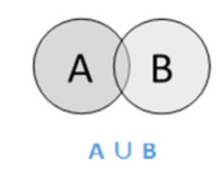
Operations on Classical Sets
Set Operations include Set Union, Set Intersection, Set Difference, Complement of Set, and Cartesian Product.
Union
The union of sets A and B (denoted by A ∪ BA ∪ B) is the set of elements which are in A, in B, or in both A and B. Hence, A ∪ B = {x|x ∈ A OR x ∈ B}.
Example − If A = {10,11,12,13} and B = {13,14,15}, then A ∪ B = {10,11,12,13,14,15} The common element occurs only once.

Slide 38
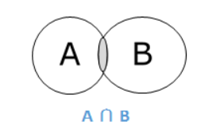
Operations on Classical Sets
Intersection
The intersection of sets A and B (denoted by A ∩ B) is the set of elements which are in both A and B. Hence, A ∩ B = {x|x ∈ A AND x ∈ B}.
Difference/ Relative Complement
The set difference of sets A and B (denoted by AB) is the set of elements which are only in A but not in B. Hence, A B = {x|x ∈ A AND x ∉ B}.

Slide 39
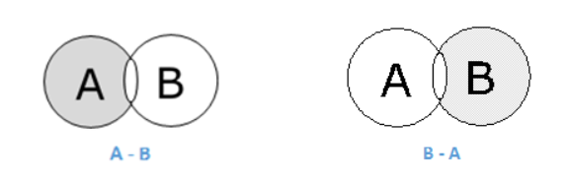
Example − If A = {10,11,12,13} and B = {13,14,15}, then (A B) = {10,11,12} and (B A) = {14,15}. Here, we can see (A B) ≠ (B A)
Complement of a Set
The complement of a set A (denoted by A) is the set of elements which are not in set A. Hence, A′ = {x|x ∉ A}.
More specifically, A′ = (UA) where U is a universal set which contains all objects.

Slide 40
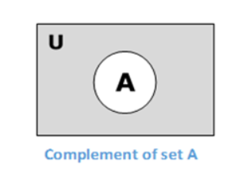
Operations on Classical Sets
Example -
− If A = {x|x belongs to set of add integers} then A′ = {y|y does not belong to set of odd integers}
Cartesian Product / Cross Product
The Cartesian product of n number of sets A1,A2,An denoted as A1 × A2...× An can be defined as all possible ordered pairs (x1,x2,xn) where x1 ∈ A1,x2 ∈ A2,xn ∈ An

Slide 41
Operations on Classical Sets
Example − If we take two sets A = {a,b} and B = {1,2},
The Cartesian product of A and B is written as A × B = {(a,1),(a,2),(b,1),(b,2)}
And, the Cartesian product of B and A is written as B × A = {(1,a),(1,b),(2,a),(2,b)}

Slide 42
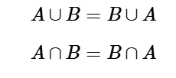
Properties of Classical Sets
Properties on sets play an important role for obtaining the solution. Following are the different properties of classical sets −
Commutative Property
Having two sets A and B, this property states −
Associative Property
Having three sets A, B and C, this property states −

Slide 43


Operations on Classical Sets
Distributive Property
Having three sets A, B and C, this property states −

Slide 44
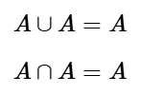
Operations on Classical Sets
Idempotency Property
For any set A, this property states −
Identity Property
For set A and universal set X, this property states −

Slide 45
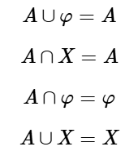

Operations on Classical Sets
Transitive Property
Having three sets A, B and C, the property states −

Slide 46

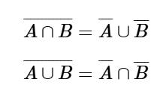
Operations on Classical Sets
Involution Property
For any set A, this property states −
De Morgans Law
It is a very important law and supports in proving tautologies and contradiction. This law states −

Slide 47
Fuzzy Logic - Set Theory
Fuzzy sets can be considered as an extension and gross oversimplification of classical sets.
It can be best understood in the context of set membership.
Basically it allows partial membership which means that it contain elements that have varying degrees of membership in the set.
From this, we can understand the difference between classical set and fuzzy set.
Classical set contains elements that satisfy precise properties of membership while fuzzy set contains elements that satisfy imprecise properties of membership.

Slide 48
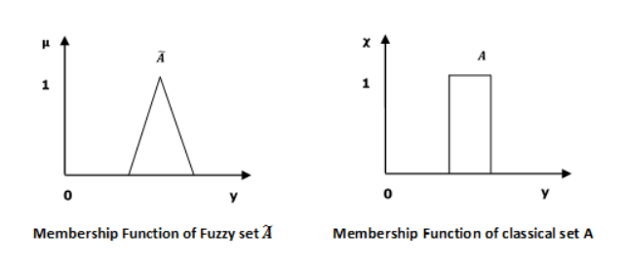
Fuzzy Logic - Set Theory

Slide 49
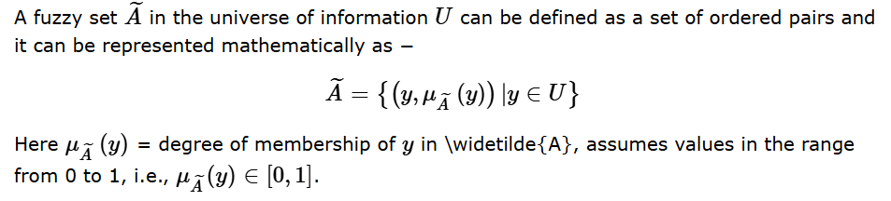
Mathematical Concept

Slide 50
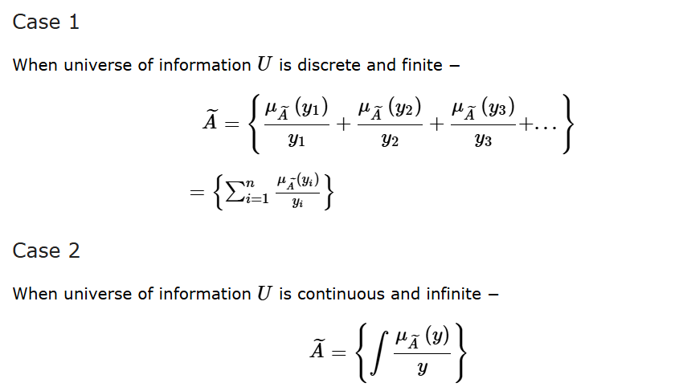
Representation of fuzzy set
Let us now consider two cases of universe of information and understand how a fuzzy set can be represented.
In the above representation, the summation symbol represents the collection of each element.

Slide 51
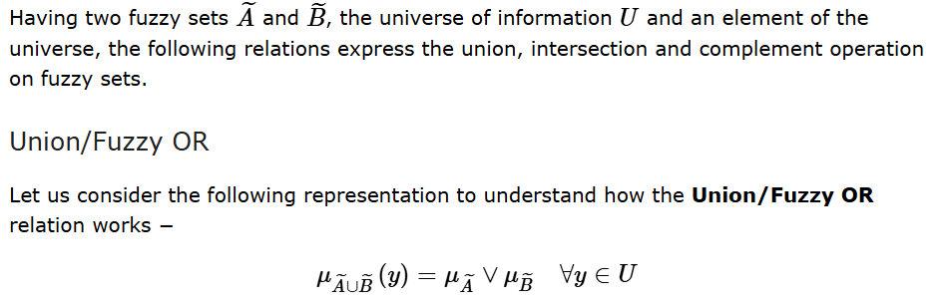
Operations on Fuzzy Sets

Slide 52
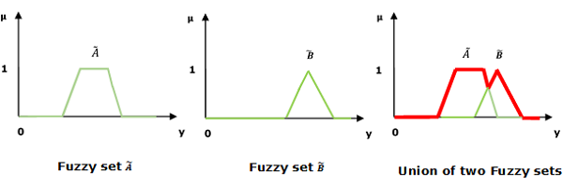
Union/Fuzzy OR
Here ∨ represents the max operation.

Slide 53
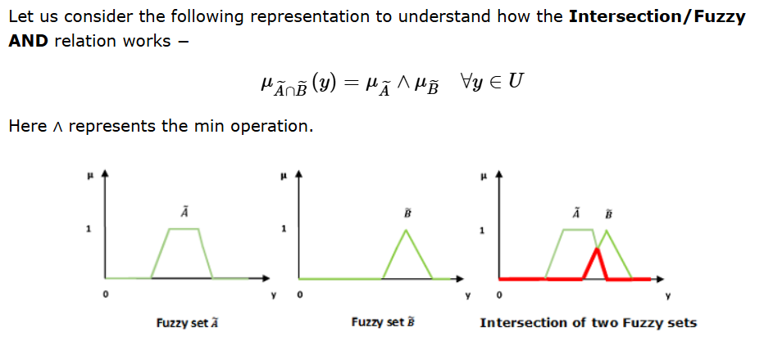
Intersection/Fuzzy AND

Slide 54
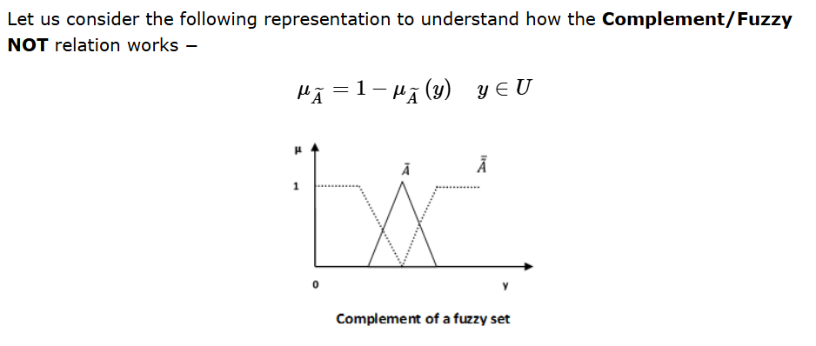
Complement/Fuzzy NOT

Slide 55
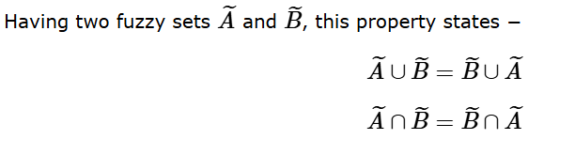
Properties of Fuzzy Sets
The different properties of fuzzy sets are -
Commutative Property -

Slide 56
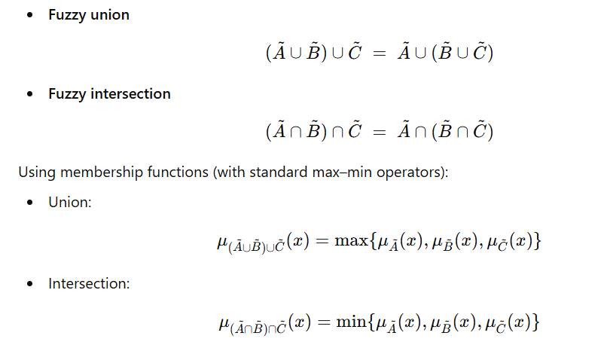
Associative Property

Slide 57
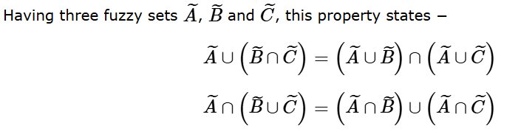
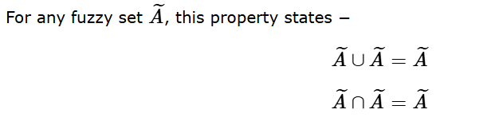
Distributive Property -
Idempotency Property -

Slide 58
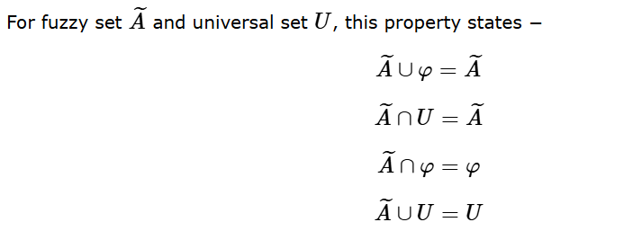

Identity Property -
Transitive Property -

Slide 59
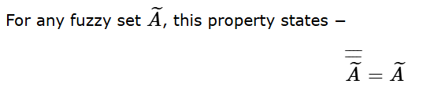
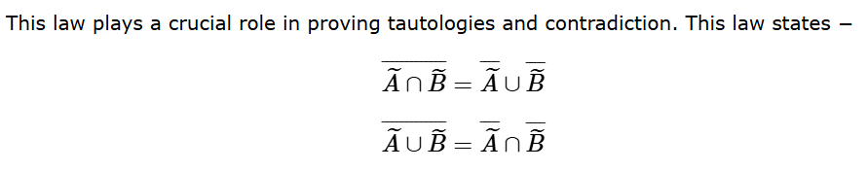
Involution Property -
De Morgans Law -

Slide 60
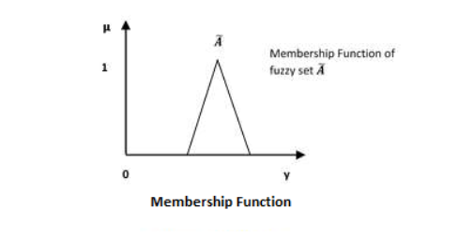
Fuzzy Logic - Membership Function
We already know that fuzzy logic is not logic that is fuzzy but logic that is used to describe fuzziness. This fuzziness is best characterized by its membership function. In other words, we can say that membership function represents the degree of truth in fuzzy logic.
Following are a few important points relating to the membership function −

Slide 61
Membership functions were first introduced in 1965 by Lofti A. Zadeh in his first research paper fuzzy sets.
Membership functions characterize fuzziness (i.e., all the information in fuzzy set), whether the elements in fuzzy sets are discrete or continuous.
Membership functions can be defined as a technique to solve practical problems by experience rather than knowledge.
Membership functions are represented by graphical forms.
Rules for defining fuzziness are fuzzy too.

Slide 62
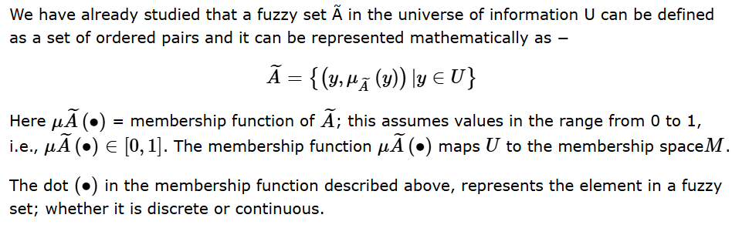
Mathematical Notation

Slide 63
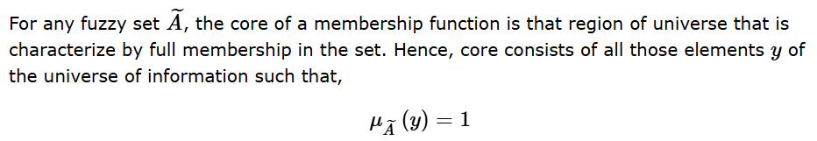
Features of Membership Functions
The different features of Membership Functions -
Core -

Slide 64
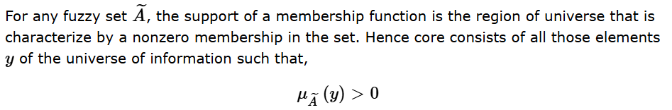
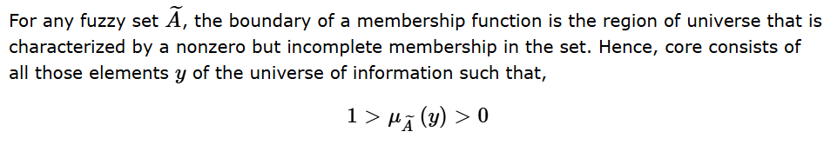
Support -
Boundary -

Slide 65
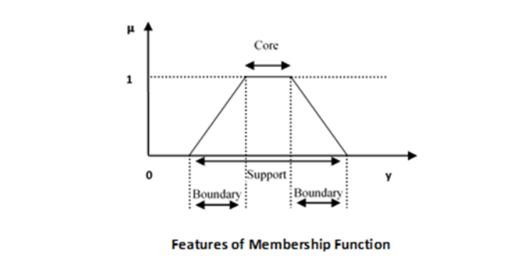

Slide 66

Fuzzification
It may be defined as the process of transforming a crisp set to a fuzzy set or a fuzzy set to fuzzier set. Basically, this operation translates accurate crisp input values into linguistic variables.
Following are the two important methods of fuzzification −
Support Fuzzification(s-fuzzification) Method -
In this method, the fuzzified set can be expressed with the help of the following relation −

Slide 67
Here the fuzzy set Q(x_{i}) is called as kernel of fuzzification. This method is implemented by keeping μ_{i} constant and x_{i} being transformed to a fuzzy set Q(x_{i}).
Grade Fuzzification (g-fuzzification) Method
It is quite similar to the above method but the main difference is that it kept x_{i} constant and μ_{i} is expressed as a fuzzy set.
OR
Grade Fuzzification (g-fuzzification) is a method that converts crisp input data into fuzzy sets by keeping the input values (x_{i})constant while representing their corresponding membership values (μ_{i}) as fuzzy sets or fuzzy numbers.

Slide 68
Unlike support fuzzification, which spreads out the input x_{i ,} g-fuzzification focuses on fuzzifying the grade of membership itself, often to model uncertainty in measurement or interpretation.
Key Characteristics of Grade Fuzzification: -
Constant Input: The crisp input value (x_{i}) remains fixed, rather than being transformed into a wider range.
Fuzzy Membership: The membership value (μ_{i}) is treated as a fuzzy variable, allowing the "grade" or "degree" of belonging to be expressed as a range or a distribution.
Applications: It is used in situations where the exact degree of membership (e.g., exactly 0.8) is uncertain, such as in subjective evaluations or noisy sensor data.
Contrast with Support Fuzzification: Support fuzzification maps a singleton (x_{i}) to a fuzzy set on the universe of discourse, whereas g-fuzzification assigns a fuzzy subset of the unit interval [0,1] to the membership value.

Slide 69
Defuzzification
It may be defined as the process of reducing a fuzzy set into a crisp set or to convert a fuzzy member into a crisp member.
We have already studied that the fuzzification process involves conversion from crisp quantities to fuzzy quantities.
In a number of engineering applications, it is necessary to defuzzify the result or rather fuzzy result so that it must be converted to crisp result.
Mathematically, the process of Defuzzification is also called rounding it off.
The different methods of Defuzzification are described below −

Slide 70

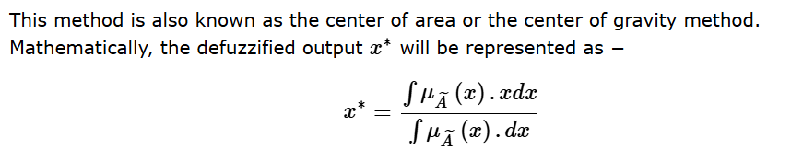
Max-Membership Method -
Centroid Method -

Slide 71
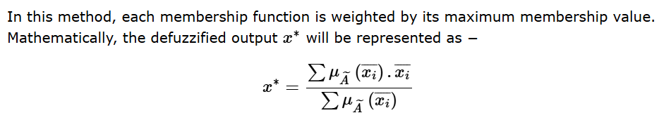
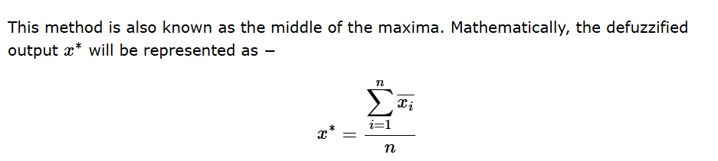
Weighted Average Method -
Mean-Max Membership -

Slide 72
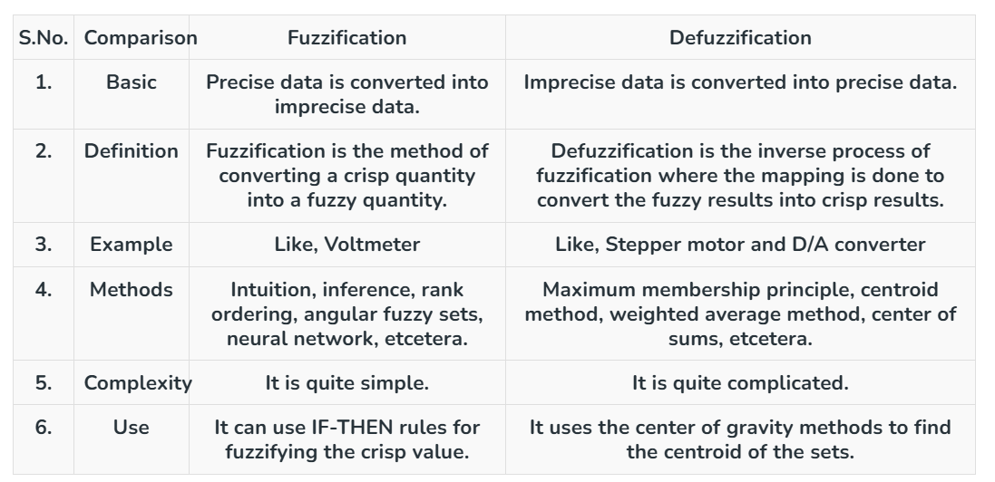
Difference between Fuzzification and Defuzzification

Slide 73
Fuzzy Relations
A fuzzy relation is defined as the cartesian product of fuzzy sets. If we have two fuzzy sets, on different universes of discourse, say:
A, on universe of discourse X, with μA(x) | x ∈ X
B, on universe of discourse Y, with μB(y) | y ∈ Y
Then, R = (A × B) ⊂ (X × Y), where the membership function of R is given by:
μR(x,y) = µA×B(x,y) = min {µA(x),µB(y)}

Slide 74
In other words, the degree of membership of each element of the newly obtained relation is the minimum degree of membership of its corresponding elements in the two fuzzy sets. To understand this better, let us take a look at an example.
If we have:
A = {(a1, 0.2), (a2, 0.7), (a3, 0.4)}
B = {(b1, 0.5), (b2, 0.6)}
Then, the relation R (AxB) would be:

Slide 75
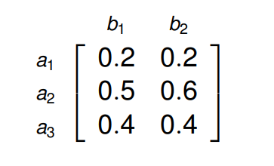
When comparing a1 in set A and b1 in set B, we find that 0.2 is a smaller value than 0.5, which is why in the relation R, the degree of membership of the element corresponding to a1 and b1 is equal to 0.2. Similarly, we can find the degrees of membership of the rest of the elements.

Slide 76
Operations on Fuzzy Relations
Let us assume that R and S are two fuzzy relations on A x B. Listed below are a few operations that can be performed on R and S.
Union -
µR∪S(a,b) = max {µR(a,b), µS(a,b)}
The union operation can only be performed if the relational matrices R and S are of the same order. Here, the degree of membership of each element of R∪S is the maximum degree of membership of its corresponding elements in R and S.

Slide 77
Intersection -
µR∩S(a,b) = min {µR(a,b), µS(a,b)}
The intersection operation can also only be performed in the relational matrices R and S are of the same order. Here, the degree of membership of each element of R∩S is the minimum degree of membership of its corresponding elements in R and S. Thus, we can say that R∩S is analogous to RxS.

Slide 78
Complement -
µR'(a,b) = 1 − µR(a,b)
The complement operation is performed on a singular relation. Here, the degree of membership of each element of the relation (after we perform the complement operation) is equal to one minus the previous degree of membership.
Composition -
T = R◦S, where:
µ(R◦S) = max y∈Y { min (µR(x,y), µS(y,z)) }
The composition operation is the most important operation that we will learn about in this article, as it is used extensively in drawing inferences from fuzzy systems. It is also called the max-min operation.

Slide 79
Here, if R is defined on X x Y and S is defined on Y x Z, then the degree of membership of each element in R◦S (X x Z) is obtained by first finding the minimum degree of membership corresponding to the elements of the two relational matrices R and S (for all y∈Y, the common term in the two relational matrices), and then finding the maximum degree of membership. This will be more clear when we take a look at an example.
If we have:
X = (x1, x2, x3)
Y = (y1, y2)
Z = (z1, z2, z3)
And the two relations R and S are given as:

Slide 80
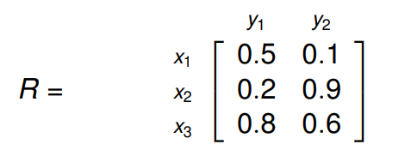
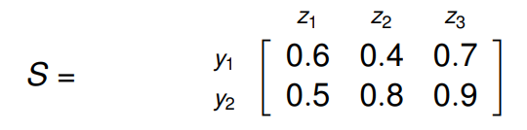
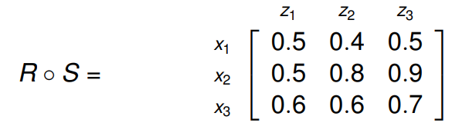
Then, R◦S will be:
To get the first element of R◦S, at index (0,0):
We first find the minimum of (0.5, 0.6) and (0.1, 0.5). Thus, we get (0.5) and (0.1). Now, we find the maximum out of these, which is (0.5). Similarly, we can find the degrees of membership of the rest of the elements.

Slide 81
Fuzzy Propositions -
Now that we have a clear idea on how to perform basic operations on fuzzy relations, we will talk about fuzzy propositions.
A fuzzy proposition, much like a classical proposition is a statement that has a truth value.
The difference between classical propositions and fuzzy propositions is that classical propositions can have a truth value of either 0 or 1, that is, they can either be entirely false or entirely true.
Fuzzy propositions, on the other hand, can have truth values in the range [0, 1].

Slide 82
For example, if we we have a proposition P, defined as:
P - The weather is pleasant.
T(P) = 0, if absolutely false.
T(P) = 0.2, if mostly false.
T(P) = 0.4, if partially false.
T(P) = 0.6, if partially true.
T(P) = 0.8, if mostly true.
T(P) = 1, if absolutely true.
Where T(P) represents the truth value of the proposition.
Traditionally, most of us have extensively dealt with two-valued logic. For example:
0 0
0 1
1 0
1 1

Slide 83
However, when we deal with fuzzy propositions, we will see ourselves often dealing with multi-valued logic. For example, if we extend our logic to include 0, 1/2 and 1, we will have:
0 0
0 1/2
1/2 0
1/2 1/2
0 1
1 0
1 1
1/2 1
1 1/2

Slide 84
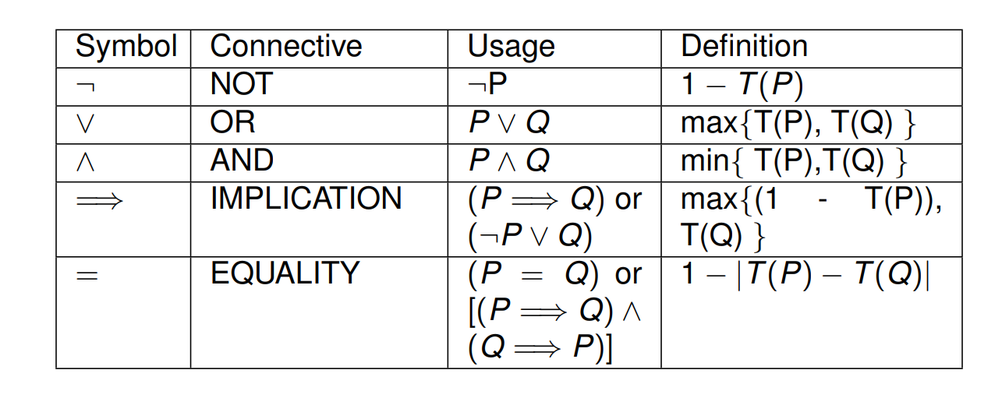
Listed below are a few operations that can be performed on propositions:
If we perform these operations on three-valued logic, we will get the following results:

Slide 85

The operations used in the above table are:
AND (∧), OR (∨), NOT (¬), IMPLICATION (⇒) and EQUAL TO (=).

Slide 86
Let us take a look at these operations being used on actual propositions. If we have:
P - Max is fast.
T(P) = 0.8
Q - Daniel is fast.
T(Q) = 0.6
Then, to find the truth value of the following statements, we have to use the above operators:
'Max is not fast.'
T(¬P) = 1 − T(P) = 0.2

Slide 87
'Max is fast and so is Daniel.'
T(P ∧ Q) = min{T(P),T(Q)} = 0.6
'Either Max is fast or Daniel is.'
T(P ∨ Q) = max{T(P),T(Q)} = 0.8
'If Max is fast, then so is Daniel.'
T(P ⇒ Q) = max{1−T(P),T(Q)} = 0.6

Slide 88
Fuzzy Implications -
A fuzzy implication, also known as a fuzzy if-then rule or a fuzzy conditional statement, takes the form:
If x is A then y is B.
Here, A and B are linguistic variables (defined by the two fuzzy sets A and B) on universes of discourses X and Y respectively. 'x is A' is often called the antecedent and 'y is B' is often called the consequence. Here are a few examples of fuzzy implications:

Slide 89
If the temperature is high, then the pressure is high.
If the number is less than or equal to zero, then the number is not a natural number.
If the fruit is ripe then the fruit is sweet, else the fruit is sour.
Now, in general, there are two ways to interpret the fuzzy rule A->B:
A coupled with B
A entails B

Slide 90
1. A coupled with B -
Here, the rule can be written as:
R:A → B = AxB = R ∫ (X×Y) [µA(x) ∗ µB(y)] | (x,y)
In the above equation, ' * ' is not the multiplication operator. It is known as a T-Norm operator. The most commonly used T-Norm operators are:
Algebraic Product: Tap(a,b) = ab
When the T-Norm operator takes this form, we call this rule the 'Larsen Rule'.
Minimum: Tmin(a,b) = min(a,b) = a ∧ b
When the T-Norm operator takes this form, we call this rule the 'Mamdani Rule'.

Slide 91
2. A entails B -
Here, there are two main ways of interpreting fuzzy implications:
Material Implication: R:A → B = A' ∪ B
Propositional Calculus: R:A → B = A' ∪ (A ∩ B)
With these two methods of interpreting fuzzy implications in mind, we can further define two fuzzy implication functions:
Zadeh's Arithmetic Rule:
Rza = A' ∪ B = ∫ (X×Y) 1 ∧ (1 − µA(x) + µB(y)) | (x,y)
As visible from the above equation, this function uses Material Implication.
Zadeh's Max-Min Rule:
Rmm = A' ∪ (A ∩ B) = ∫ (X×Y) (1 − µA(x)) ∨ (µA(x) ∧ µB(y)) | (x,y)
As visible from the above equation, this function uses Propositional Calculus.

Slide 92
Say we have two universes of discourses, X and Y, defined as:
X = {a, b, c, d}
Y = {1, 2, 3, 4}
Let there be two fuzzy sets, A and B, defined on these two universes of discourses, as:
A = {(a, 0.0),(b, 0.8),(c, 0.6),(d, 1.0)}
B = {(1, 0.2),(2, 1.0),(3, 0.8),(4, 0.0)}
From this, we have to determine the implication:
'If x is A then y is B.'
Let us use Zadeh's Max-Min Rule to arrive at a conclusion. We know that:
From Zadeh's Max-Min Rule,

Slide 93

R:A → B = A' ∪ (A ∩ B)
Now, we also know that A ∩ B can simply be written as A x B.
Thus, A' ∪ (A ∩ B) can be re-written as (A x B) ∪ (A' x Y), since the cross-product of Y with A' will simply give us A'.
Now, let us find A x B:

Slide 94


And now let us find A' x Y:
Putting these two terms together, we can find R:A → B = (A x B) ∪ (A' x Y) as:

Slide 95
Fuzzy Inferences
We use two inferring procedures in fuzzy systems:
1. Generalized Modus Ponens (GMP) -
If we have the statement:
If x is A then y is B.
And if we are given:
x is A'.
Then, by using Generalized Modus Ponens, we can infer:
y is B'.
We have to find B', which, from Zadeh's Max-Min Rule can be written as:
B' = A' ◦ R(x,y), where R(x,y) = max {(A x B),(A' x Y)} (1)

Slide 96
Let's consider two fuzzy sets A and B, defined on universes of discourse X and Y respectively. Now,
assume that a proposition - 'If x is A then y is B' is given to us, where:
A = {(x1, 0.5),(x2, 1),(x3, 0.6)}
B = {(y1, 1),(y2, 0.4)}
Further, assume that we are given:
x is A', where A' = {(x1, 0.6),(x2, 0.9),(x3, 0.7)}.
From this, we are to derive a conclusion of the form:
y is B', using Generalized Modus Ponens.

Slide 97


From equation (1), we know that we first have to find (A x B) and then (A' x Y), after which we have to perform the composition of A' and the maximum of (A x B) and (A' x Y).
First, let us find (A x B).
Now, let us find (A' x Y).

Slide 98


Now that we have (A x B) and (A' x Y), we can find R(x,y) = max {(A x B),(A' x Y)}.
And finally, we can perform the composition of A' and R(x,y).
Thus, we derive that y is B' where B' = {(y1, 0.9),(y2, 0.5)}.

Slide 99
2 . Generalized Modus Tollens (GMT) -
This inference procedure is very similar to GMP. The only difference lies in the methods of application of these two procedures. Here, if we have the statement:
If x is A then y is B.
And if we are given:
y is B'.
Then, by using Generalized Modus Tollens, we can infer:
x is A'.
Let's consider an example.

Slide 100
Assume that a proposition - 'If x is A then y is B' is given to us, where:
A = {(x1, 0.5),(x2, 1.0),(x3, 0.6)}
B = {(y1, 0.6),(y2, 0.4)}
Now, assume that we are given:
y is B', where B' = {(y1, 0.9),(y2, 0.7)}.
From this information, we are to infer:
x is A', using Generalized Modus Tollens.
Hence, we first calculate R(x,y) = max{(A × B),(A' × y)}.

Slide 101


Now that we have R(x,y), we can calculate A', which is equal to B' ◦ R(x, y).
Thus, we derive that x is A' where A' = {(x1, 0.5),(x2, 0.9),(x3, 0.6)}.

Slide 102
Fuzzy Logic Rule Base -
It is a known fact that a human being is always comfortable making conversations in natural language. The representation of human knowledge can be done with the help of following natural language expression −
IF antecedent THEN consequent
The expression as stated above is referred to as the Fuzzy IF-THEN rule base.
Canonical Form
Following is the canonical form of Fuzzy Logic Rule Base −
Rule 1 − If condition C1, then restriction R1
Rule 2 − If condition C1, then restriction R2
Rule n − If condition C1, then restriction Rn

Slide 103
Interpretations of Fuzzy IF-THEN Rules -
Fuzzy IF-THEN Rules can be interpreted in the following four forms −
Assignment Statements -
These kinds of statements use = (equal to sign) for the purpose of assignment. They are of the following form −
a = hello
climate = summer
Conditional Statements -
These kinds of statements use the IF-THEN rule base form for the purpose of condition. They are of the following form −
IF temperature is high THEN Climate is hot
IF food is fresh THEN eat.

Slide 104
Unconditional Statements
They are of the following form −
GOTO 10
turn the Fan off

Slide 105
Fuzzy logic controller design
In designing a fuzzy logic controller, the process of forming fuzzy rules plays a vital role. There are four structures of the fuzzy production rule system (Weiss and Donnel, 1979) which are as follows:
A set of rules that represents the policies and heuristic strategies of the expert decision-maker.
A set of input data that are assessed immediately prior to the actual decision.
A method for evaluating any proposed action in terms of its conformity to the expressed rules when there is available data.
A method for generating promising actions and determining when to stop searching for better ones.

Slide 106
Architecture and Operations of FLC System:
The principal components of an FLC system is a fuzzifier, a fuzzy rule base, a fuzzy knowledge base, an inference engine, and a defuzz.ifier.
It also includes parameters for normalization. When the output from the defuzzifier is not a control action for a plant, then the system is a fuzzy logic decision system.
The fuzzifier present converts crisp quantities into fuzzy quantities. The fuzzy rule base stores knowledge about the operation of the process of domain expertise.
The fuzzy knowledge base stores the knowledge about all the input-output fuzzy relationships. It includes the membership functions defining the input variables to the fuzzy rule base and the out variables to the plant under control.
The inference engine is the kernel of an FLC system, and it possesses the capability to simulate human decisions by performing approximate reasoning to achieve the desired control strategy.

Slide 107

The defuzzifier converts the fuzzy quantities into crisp quantities from an inferred fuzzy control action by the inference engine.

Slide 108
The various steps involved in designing a fuzzy logic controller are as follows:
Step 1: Locate the input, output, and state variables of the plane under consideration.
Step 2: Split the complete universe of discourse spanned by each variable into a number of fuzzy subsets, assigning each with a linguistic label. The subsets include all the elements in the universe.
Step 3: Obtain the membership function for each fuzzy subset.
Step 4: Assign the fuzzy relationships between the inputs or states of fuzzy subsets on one side and the output of fuzzy subsets on the other side, thereby forming the rule base.
Step 5: Choose appropriate scaling factors for the input and output variables for normalizing the variables between [0, 1] and [-1, I] interval.
Step 6: Carry out the fuzzification process.

Slide 109
Step 7: Identify the output contributed from each rule using fuzzy approximate reasoning.
Step 8: Combine the fuzzy outputs obtained from each rule.
Step 9: Finally, apply defuzzification to form a crisp output.
The above steps are performed and executed for a simple FLC system. The following design elements are adopted for designing a general FLC system:
Fuzzification strategies and the interpretation of a fuzzifier.
Fuzzy knowledge base: Normalization of the parameters involved; partitioning of input and output spaces; selection of membership functions of a primary fuzzy set.
Fuzzy rule base: Selection of input and output variables; the source from which fuzzy control rules are to be derived; types of fuzzy control rules; completeness of fuzzy control rules.

Slide 110
Decision· making logic: The proper definition of fuzzy implication; interpretation of connective "and"; interpretation of connective "or"; inference engine.
Defuzzification materials and the interpretation of a defuzzifier.
Applications:
FLC systems find a wide range of applications in various industrial and commercial products and systems. In several applications- related to nonlinear, time-varying, ill-defined systems and also complex systems - FLC systems have proved to be very efficient in comparison with other conventional control systems. The applications of FLC systems include:
Traffic Control
Steam Engine
Aircraft Flight Control
Missile Control

Slide 111
Adaptive Control
Liquid-Level Control
Helicopter Model
Automobile Speed Controller
Braking System Controller
Process Control (includes cement kiln control)
Robotic Control
Elevator (Automatic Lift) control;
Automatic Running Control
Cooling Plant Control
Water Treatment
Boiler Control;
Nuclear Reactor Control;
Power Systems Control;
Air Conditioner Control (Temperature Controller)
Biological Processes
Knowledge-Based System
Fault Detection Control Unit
Fuzzy Hardware implementation and Fuzzy Computers

Slide 112
Thank You

